Slide 1
$project

Slide 2
$project
$project allows you to choose which attributes will be returned
You can also rename attributes

Slide 3
High level syntax
{$project:{existingField:<0 or 1>
…
}}

Slide 4
High level syntax
{$project:{newField:”$oldField”
…
}}

Slide 5
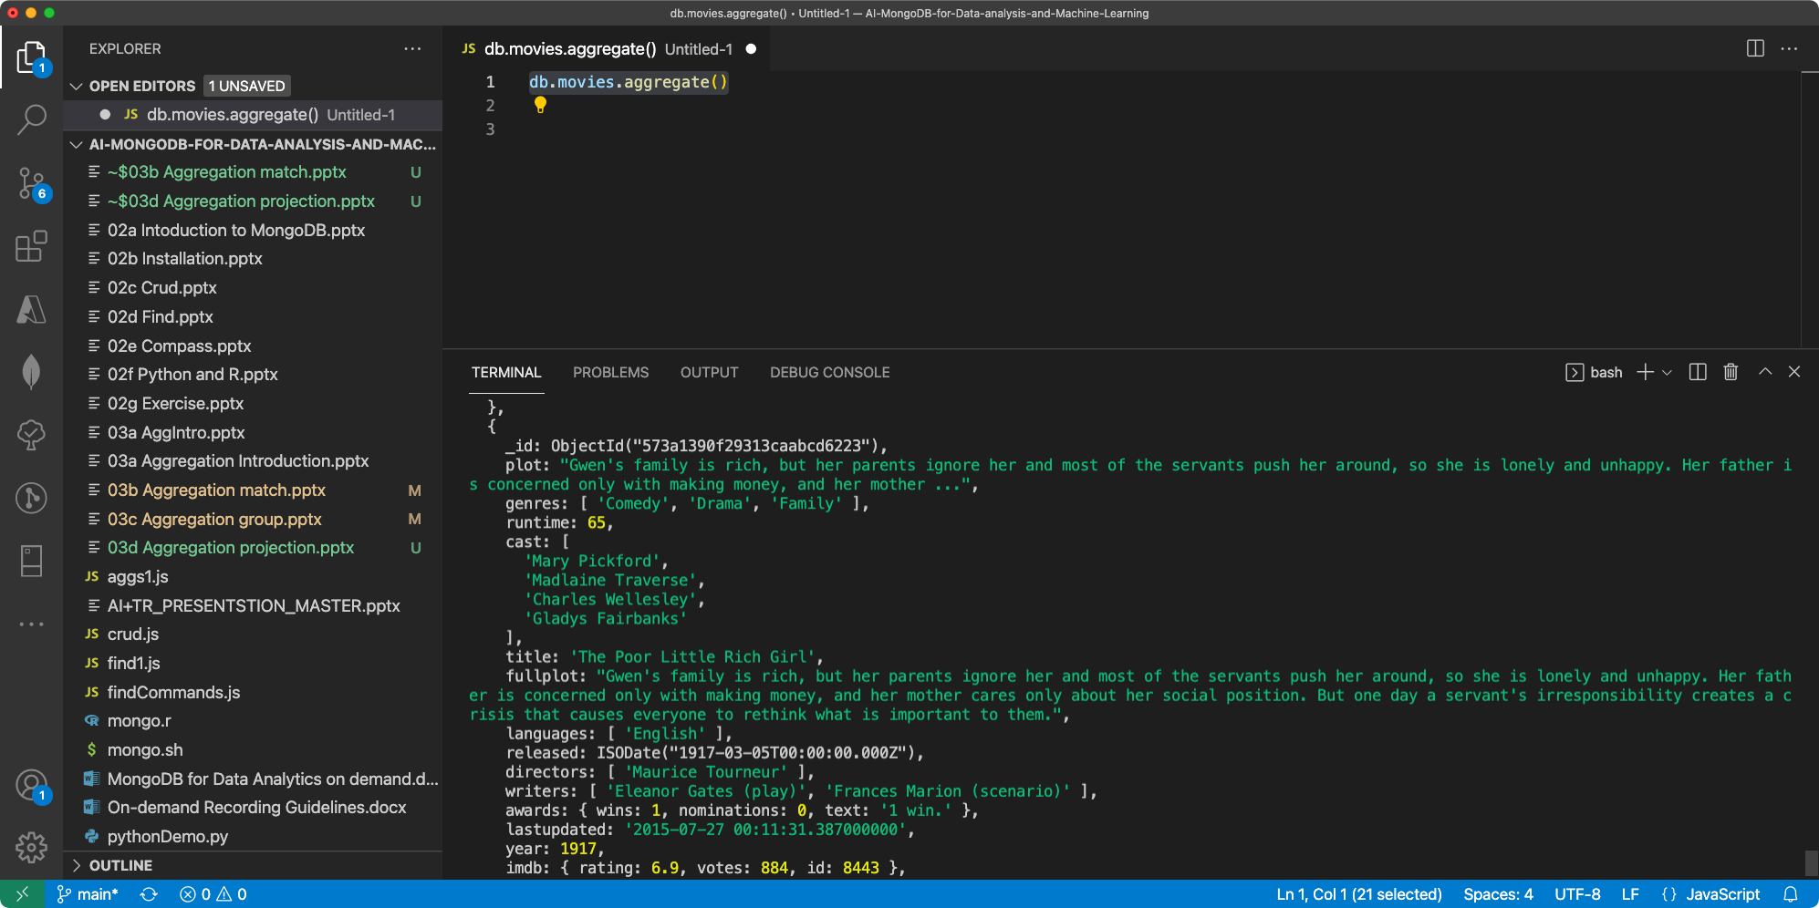

Slide 6
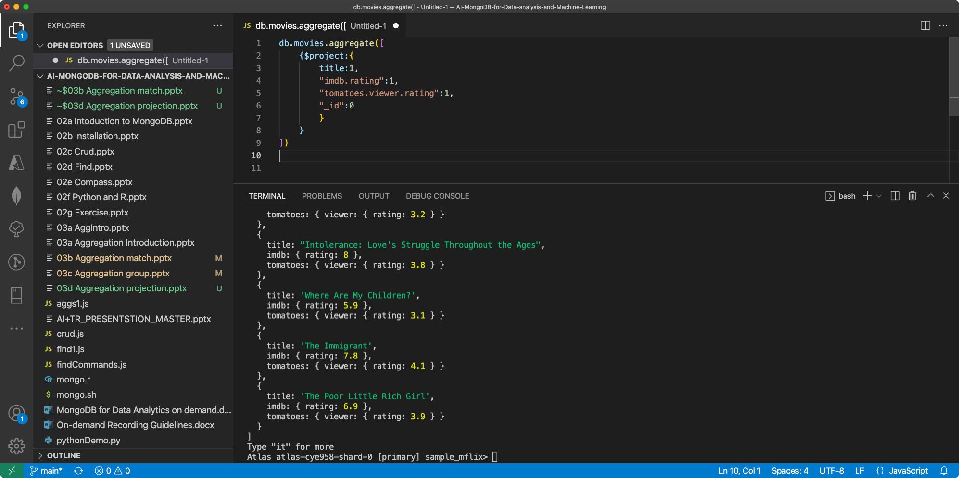
_id is always shown, unless explicitly suppressed

Slide 7
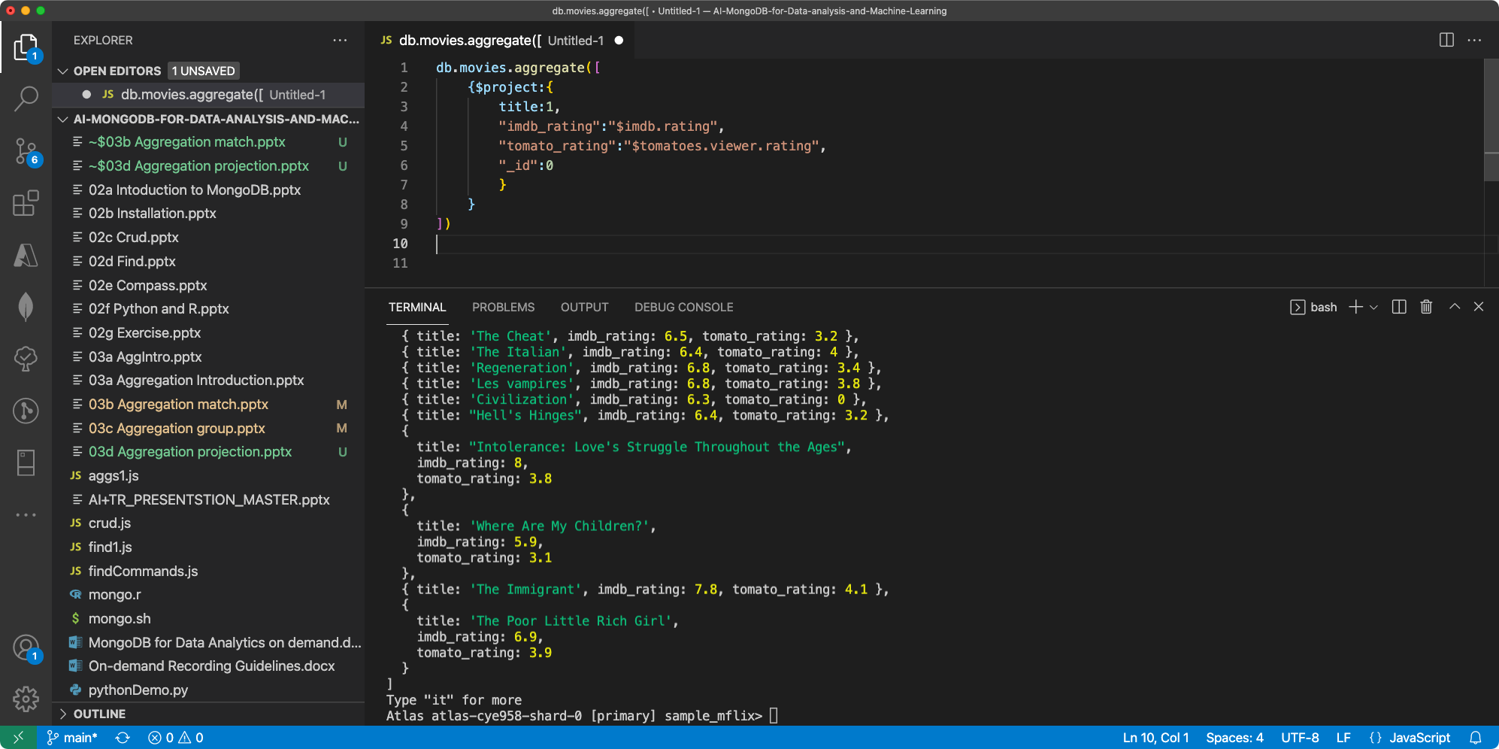
Rename this
To that

